Slide 1
Process API

Slide 2
What API does the OS provide to user programs?
API = Application Programming Interface
= functions available to write user programs
API provided by OS is a set of “system calls”
System call is a function call into OS code that runs at a higher privilege level of the CPU
Sensitive operations (e.g., access to hardware) are allowed only at a higher privilege level

Slide 3
So, should we rewrite programs for each OS?
POSIX API: a standard set of system calls that an OS must implement
Programs written to the POSIX API can run on any POSIX compliant OS
Most modern OSes are POSIX compliant
Ensures program portability
Program language libraries hide the details of invoking system calls
The printf function in the C library calls the write system call to write to screen
User programs usually do not need to worry about invoking system calls

Slide 4
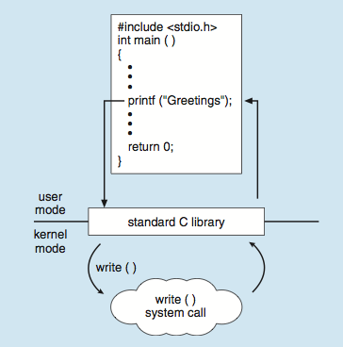
Example -- Standard C Library
C program invoking printf() library call, which calls write() system call

Slide 5
Process related system calls (in Unix)
fork() creates a new child process
All processes are created by forking from a parent
The init process is ancestor of all processes
exec() makes a process execute a given executable
exit() terminates a process
wait() causes a parent to block until child terminates
Many variants exist of the above system calls with different arguments

Slide 6
What happens during a fork?
A new process is created by making a copy of parent’s memory image
The new process is added to the OS process list and scheduled
Parent and child start execution just after fork (with different return values)
Parent and child execute and modify the memory data independently

Slide 7
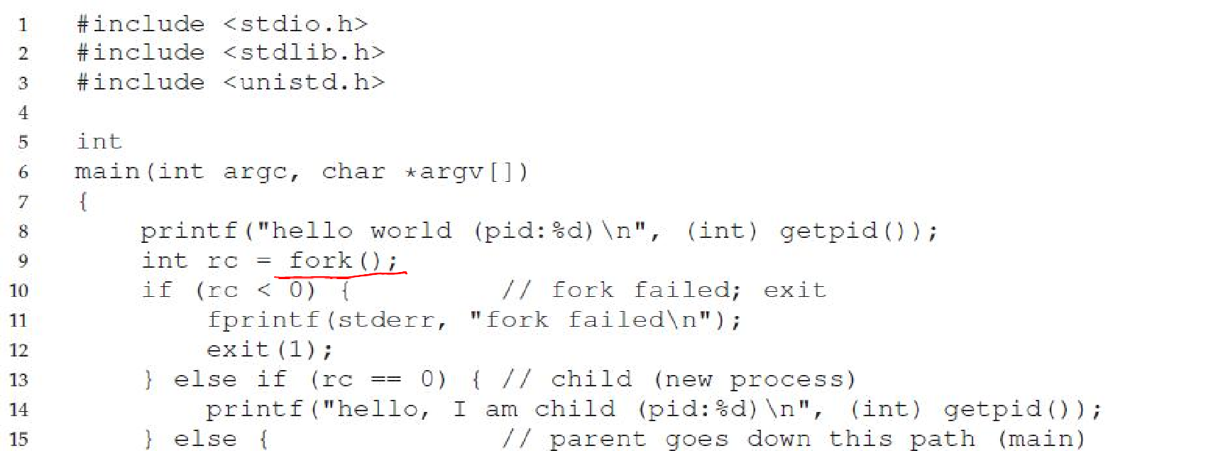
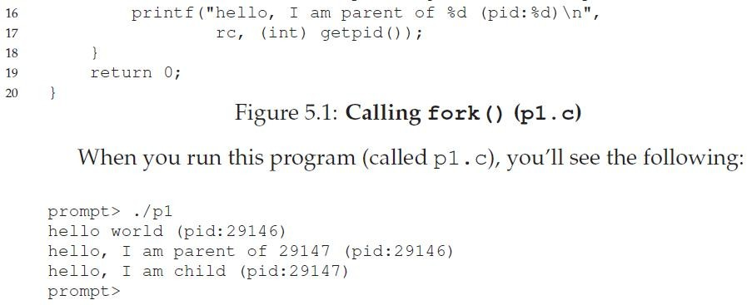

Slide 8
Waiting for children to die…
Process termination scenarios
By calling exit() (exit is called automatically when end of main is reached)
OS terminates a misbehaving process
Terminated process exists as a zombie
When a parent calls wait(), zombie child is cleaned up or “reaped”
wait() blocks in parent until child terminates (non-blocking ways to invoke wait exist)
What if parent terminates before child? init
process adopts orphans and reaps them

Slide 9
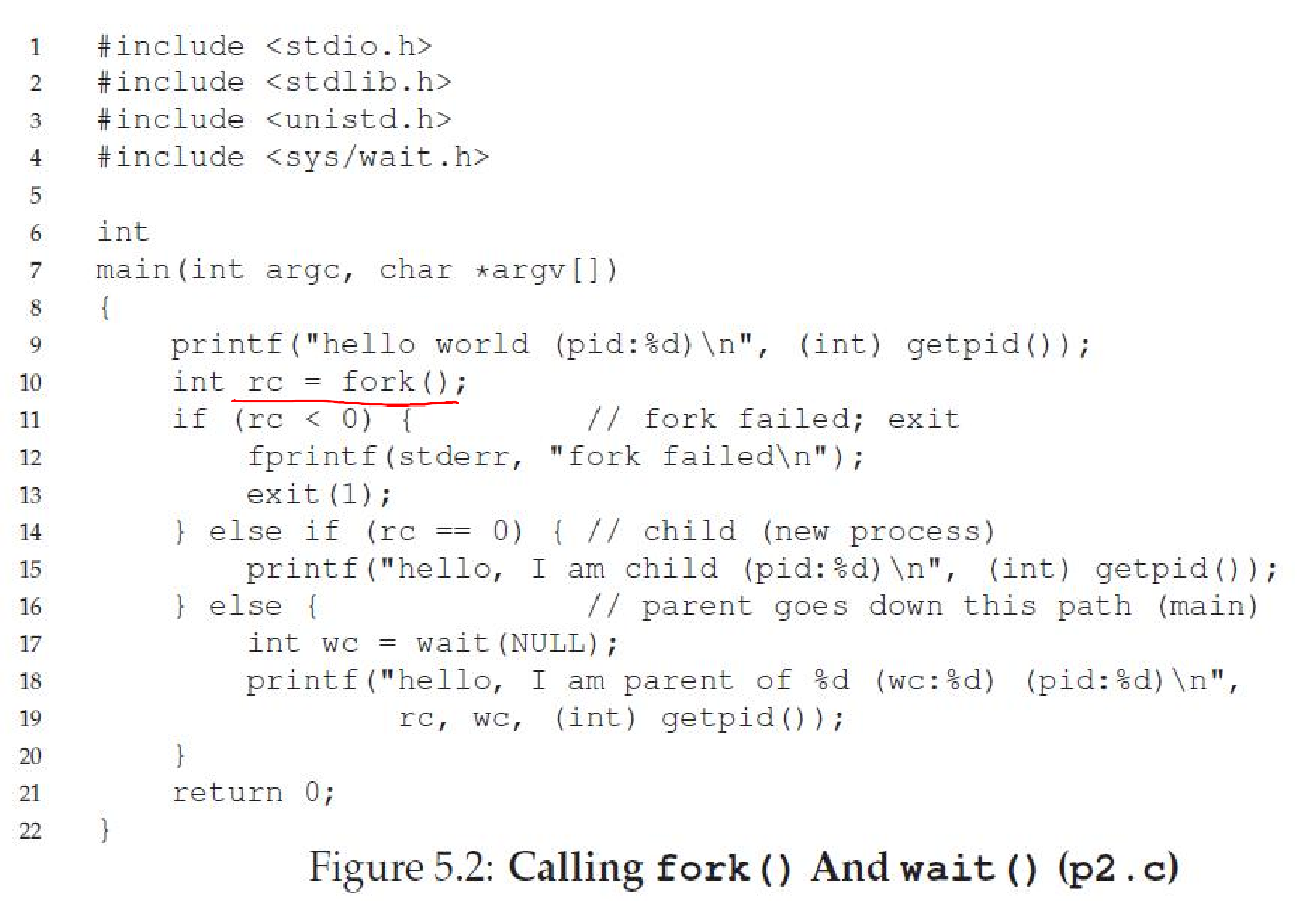

Slide 10
What happens during exec?
After fork, parent and child are running same code
Not too useful!
A process can run exec() to load another executable to its memory image
So, a child can run a different program from parent
Variants of exec(), e.g., to pass commandline arguments to new executable

Slide 11
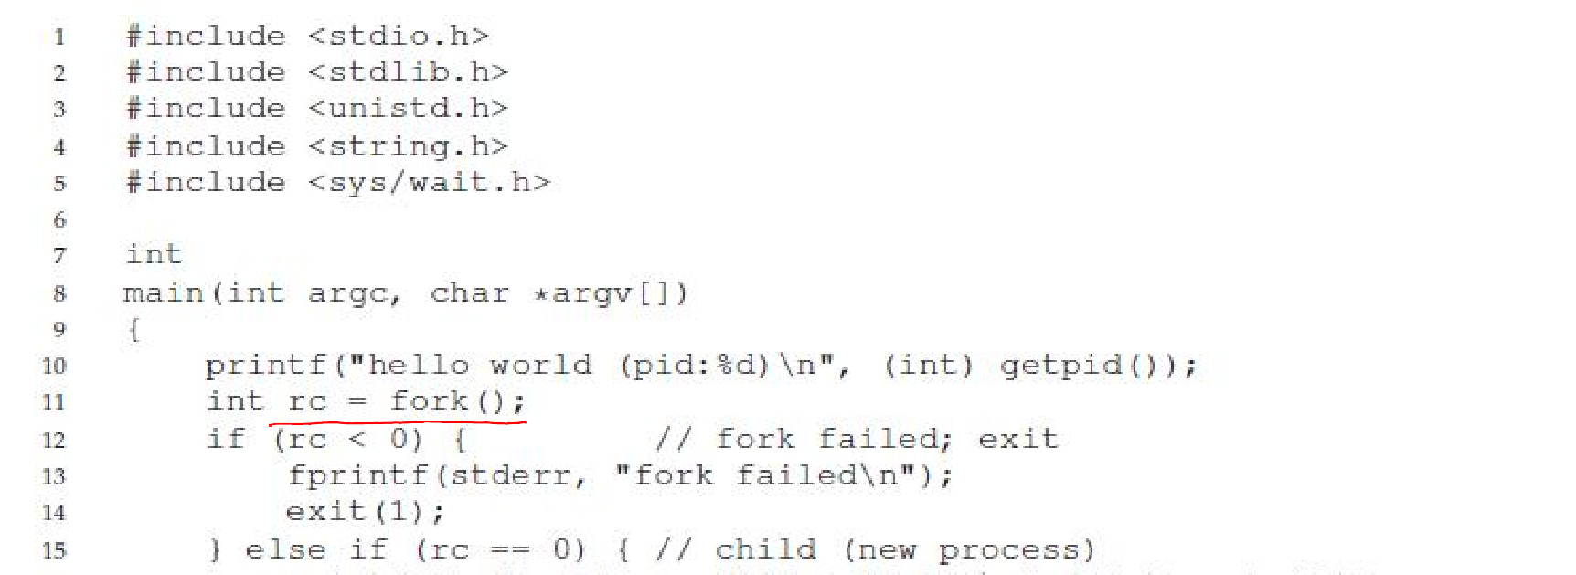
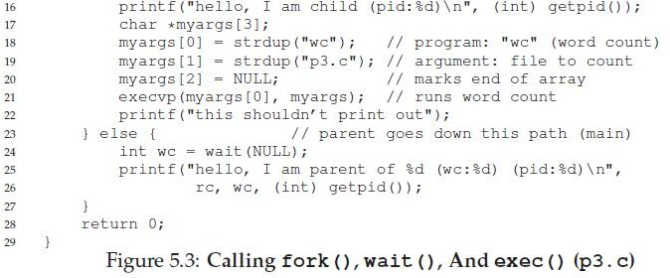
11

Slide 12
Case study: How does a shell work?
In a basic OS, the init process is created after initialization of hardware
The init process spawns a shell like bash
Shell reads user command, forks a child, execs the command executable, waits for it to finish, and reads next command
Common commands like ls are all executables that are simply exec’ed by the shell
prompt>ls
a.txt b.txt c.txt
12

Slide 13
More funky things about the shell
Shell can manipulate the child in strange ways
Suppose you want to redirect output from a command to a file
prompt>ls > foo.txt
Shell spawns a child, rewires its standard output to a file, then calls exec on the child
13

Slide 14
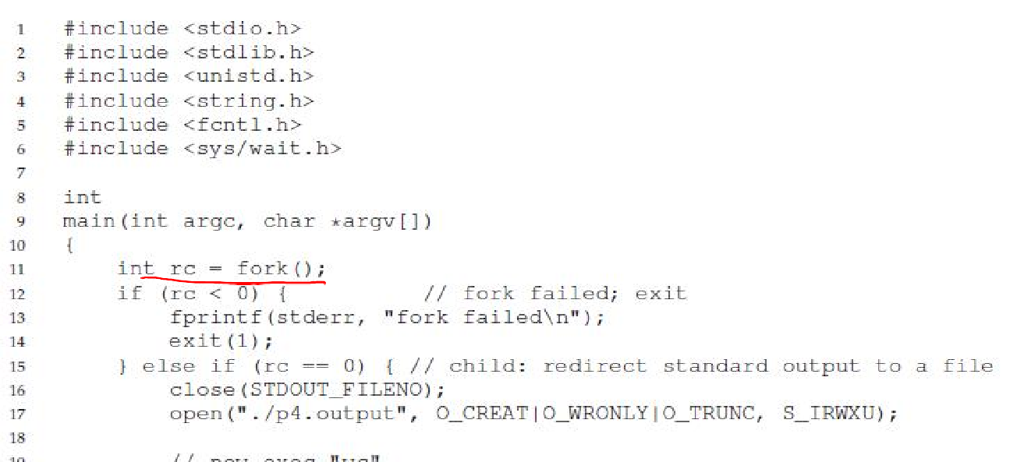
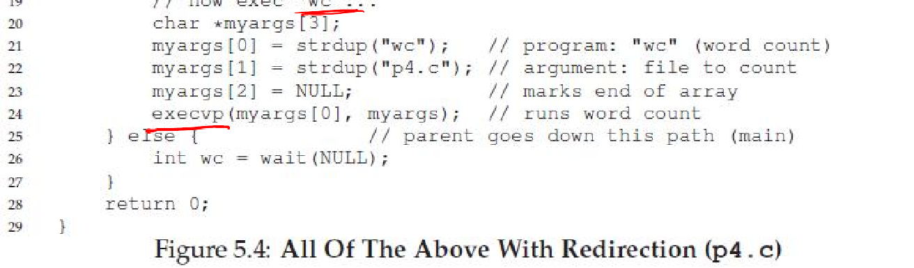
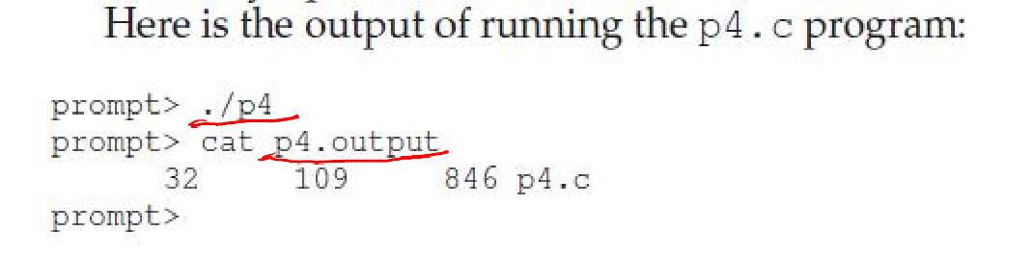
14

